Slide 1
Hospital Management System
PRESENTED BY
TUNG TZE JUN
OOI HONG ZHI
CHONG ZHENG YUAN

Slide 2
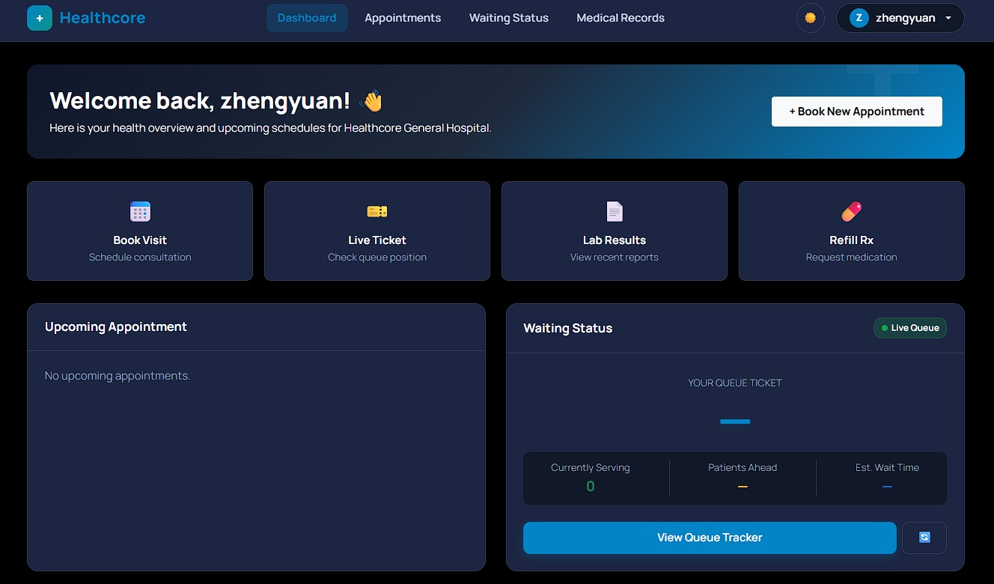
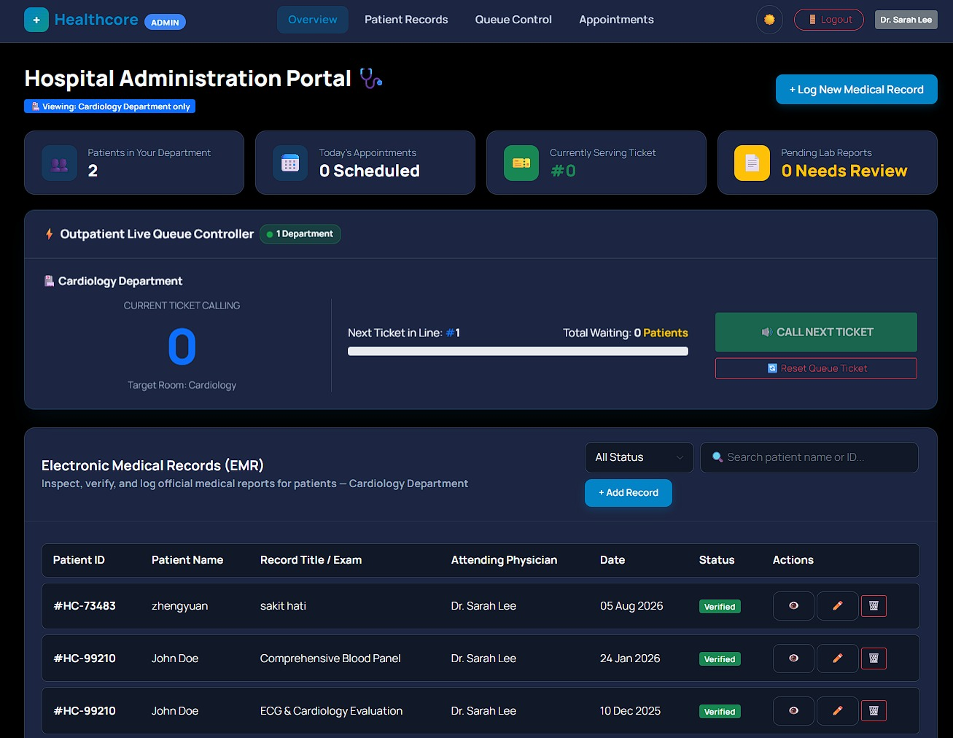
Web-Based Healthcare Administrative & Patient Management Platform
Purpose of the Website:
  Provide a centralized web-based interface to manage hospital administration, dynamic patient dynamic profiles, and user authentication seamlessly.
  Bridge client-side user experience with backend relational database storage.
Website Design Concept:
  Clean, professional medical layout focusing on readability, structural navigation, and ease of access for both users and administrators.
-Patient page
-DOCTOR page

Slide 3


Project Concept & Target Audience
Inspiration & Background:
  Traditional healthcare administrative workflows often face challenges with fragmented patient records, slow paper-based processing, and unintuitive interfaces.
  Inspired by the need for accessible, modern web technologies to simplify administrative overhead and user data management.
Core Motivation:
  Build a lightweight, scalable, full-stack hospital management web application that handles user authentication, profile customization, administrative control, and database persistence.

Slide 4

Project Concept & Target Audience
Target Audience & Primary Users:
  Hospital Administrators: Need quick access to manage system records and configuration settings.
  Patients / Registered Users: Require secure account creation, personal profile viewing, and account customization options.
Needs Fulfilled:
  Role-based flow handling (Authentication & Admin views).
  Data persistence for user accounts and system state.
  Intuitive portal for personal record management (profile.php and settings.html).

Slide 5
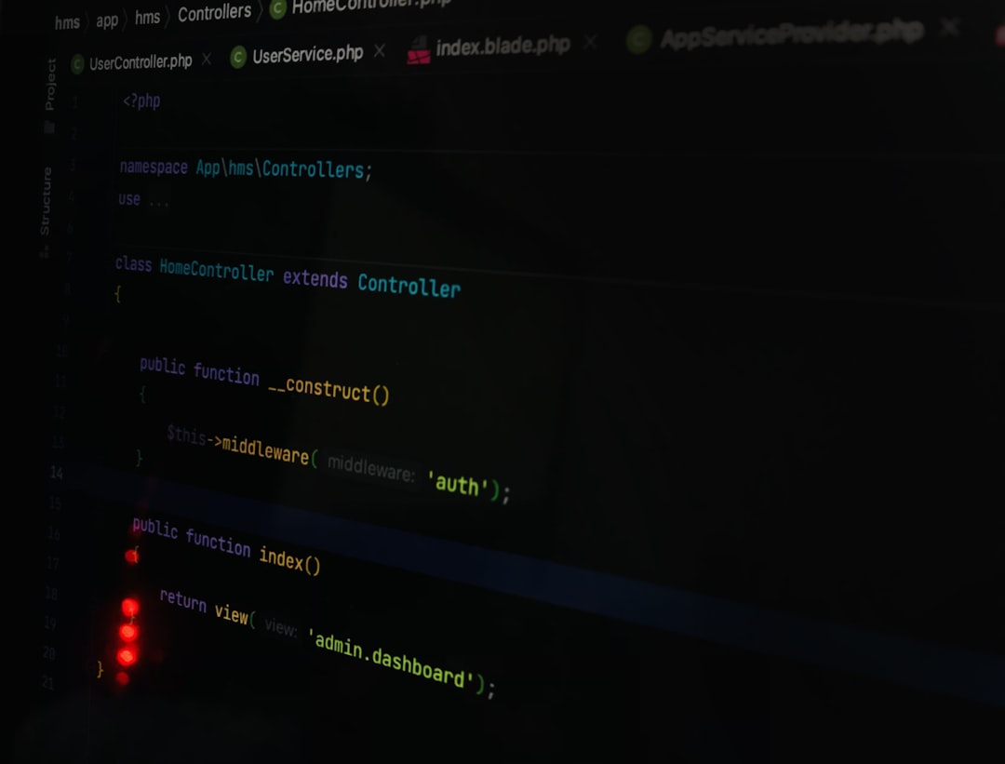


Development Stack & Tools
HTML5 for Structure
CSS3 for Styling
JavaScript for Interactivity
HTML5 forms the backbone of the platform, creating accessible, semantic pages like index.html and profile.html, ensuring compatibility across browsers and devices for seamless user interaction.
CSS3 styles the interface with a professional palette, responsive layouts, and intuitive navigation, enhancing readability and user experience on desktops, tablets, and smartphones.
JavaScript adds dynamic behaviors such as form validation, real-time updates, and interactive dashboards, improving usability and engagement for hospital staff and patients.

Slide 6


Development Stack & Tools
PHP for Loop
MySQL for storing
  Server-side business logic and routing.
  Session maintenance and auth guards.
  Dynamic content loading via auth.php.
Relational tables (users, doctors, patients).
PDO connectivity with error handling.
Pre-configured schema and seed data.

Slide 7
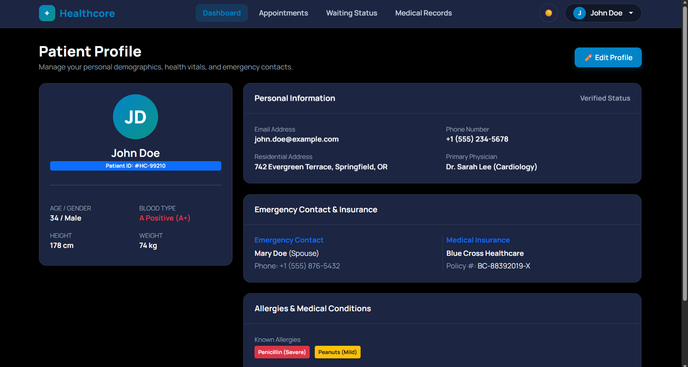
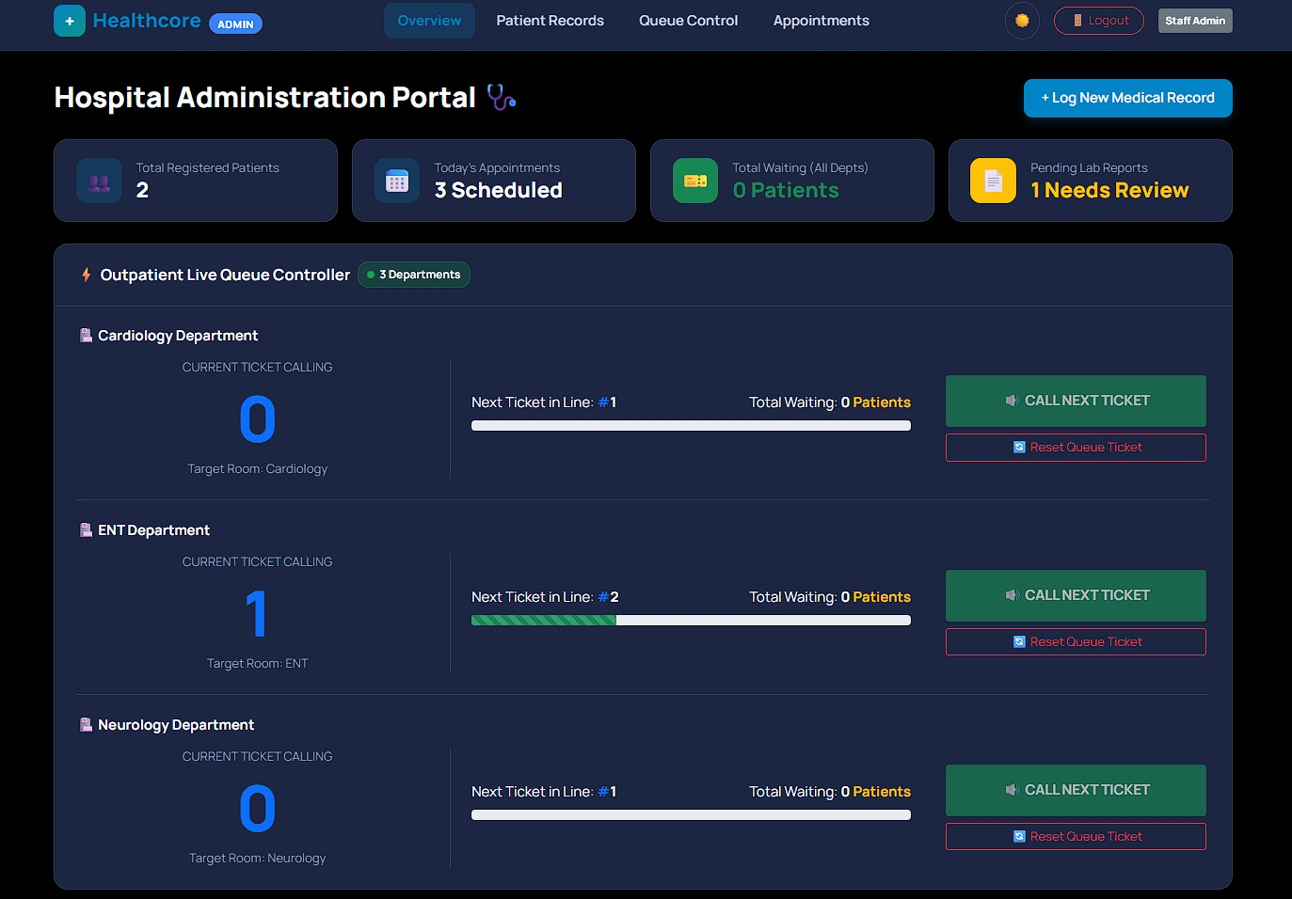
Key Functionalities & Standout Features
Core System Features:
  User Authentication Engine: Secure registration, login handling, session maintenance (auth.php), and safe logout workflows (logout.php).
  Administrative Dashboard: Centralized panel (admin.html/admin.php) to view and oversee system data and operations.
  Dynamic Profile & Settings Management: Allows registered users to view profile details and adjust preferences through backend script integration.
  Database Auto-Seeding & Schema: Pre-configured SQL schema execution and dataset populator script (seed.php) for rapid deployment and testing.
Profile page
ADMIN Page

Slide 8
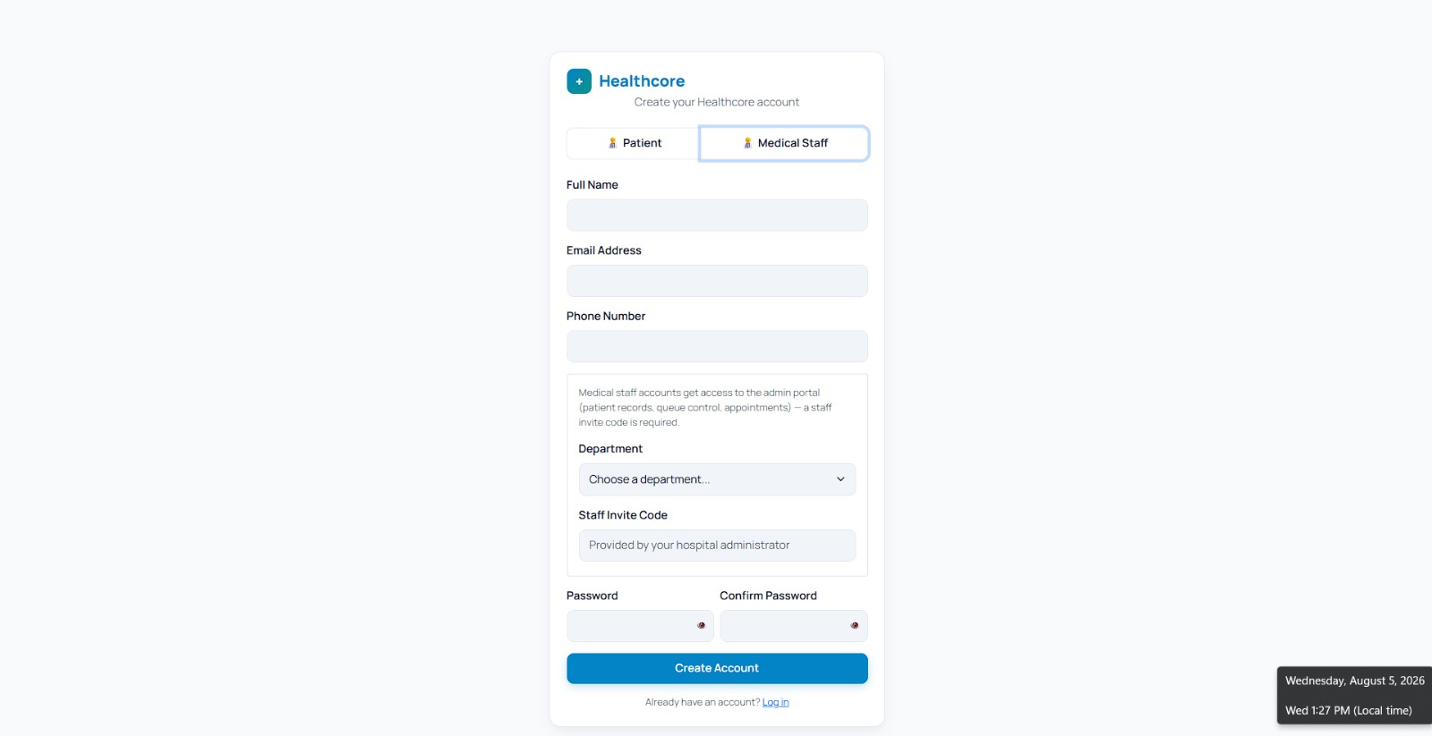
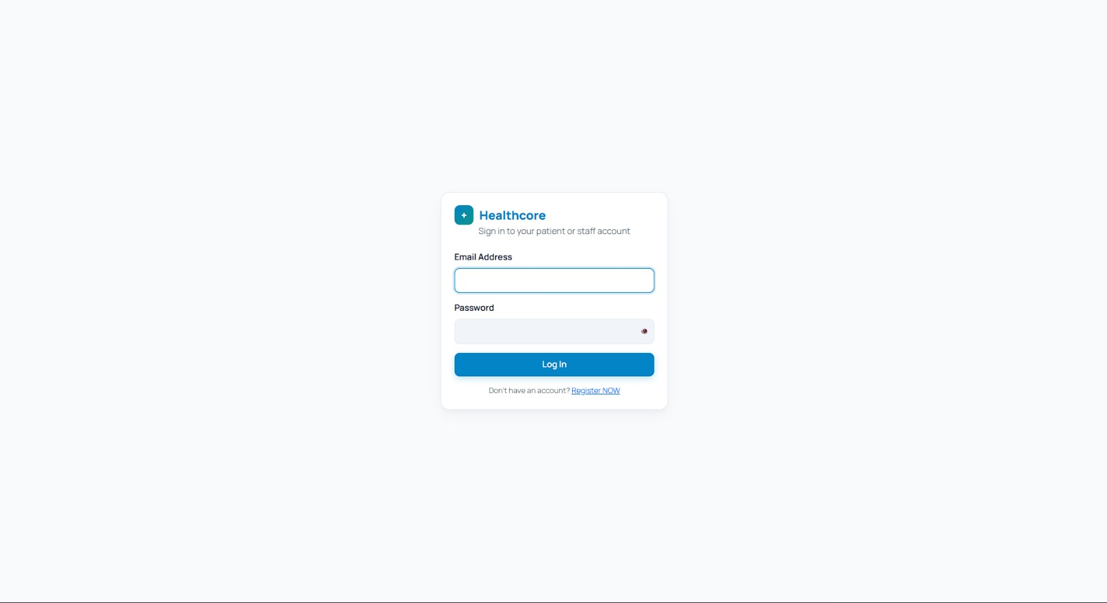
Key Functionalities & Standout Features
Standout Design & Architectural Highlights:
Hybrid Template Architecture: Clear separation between backend execution logic (PHP) and static interface layouts (HTML/CSS).
Modular Database Handlers: Centralized database connection logic (db.php) allowing efficient SQL execution across all dynamic endpoints.
REgister page
LOGIN page

Slide 9
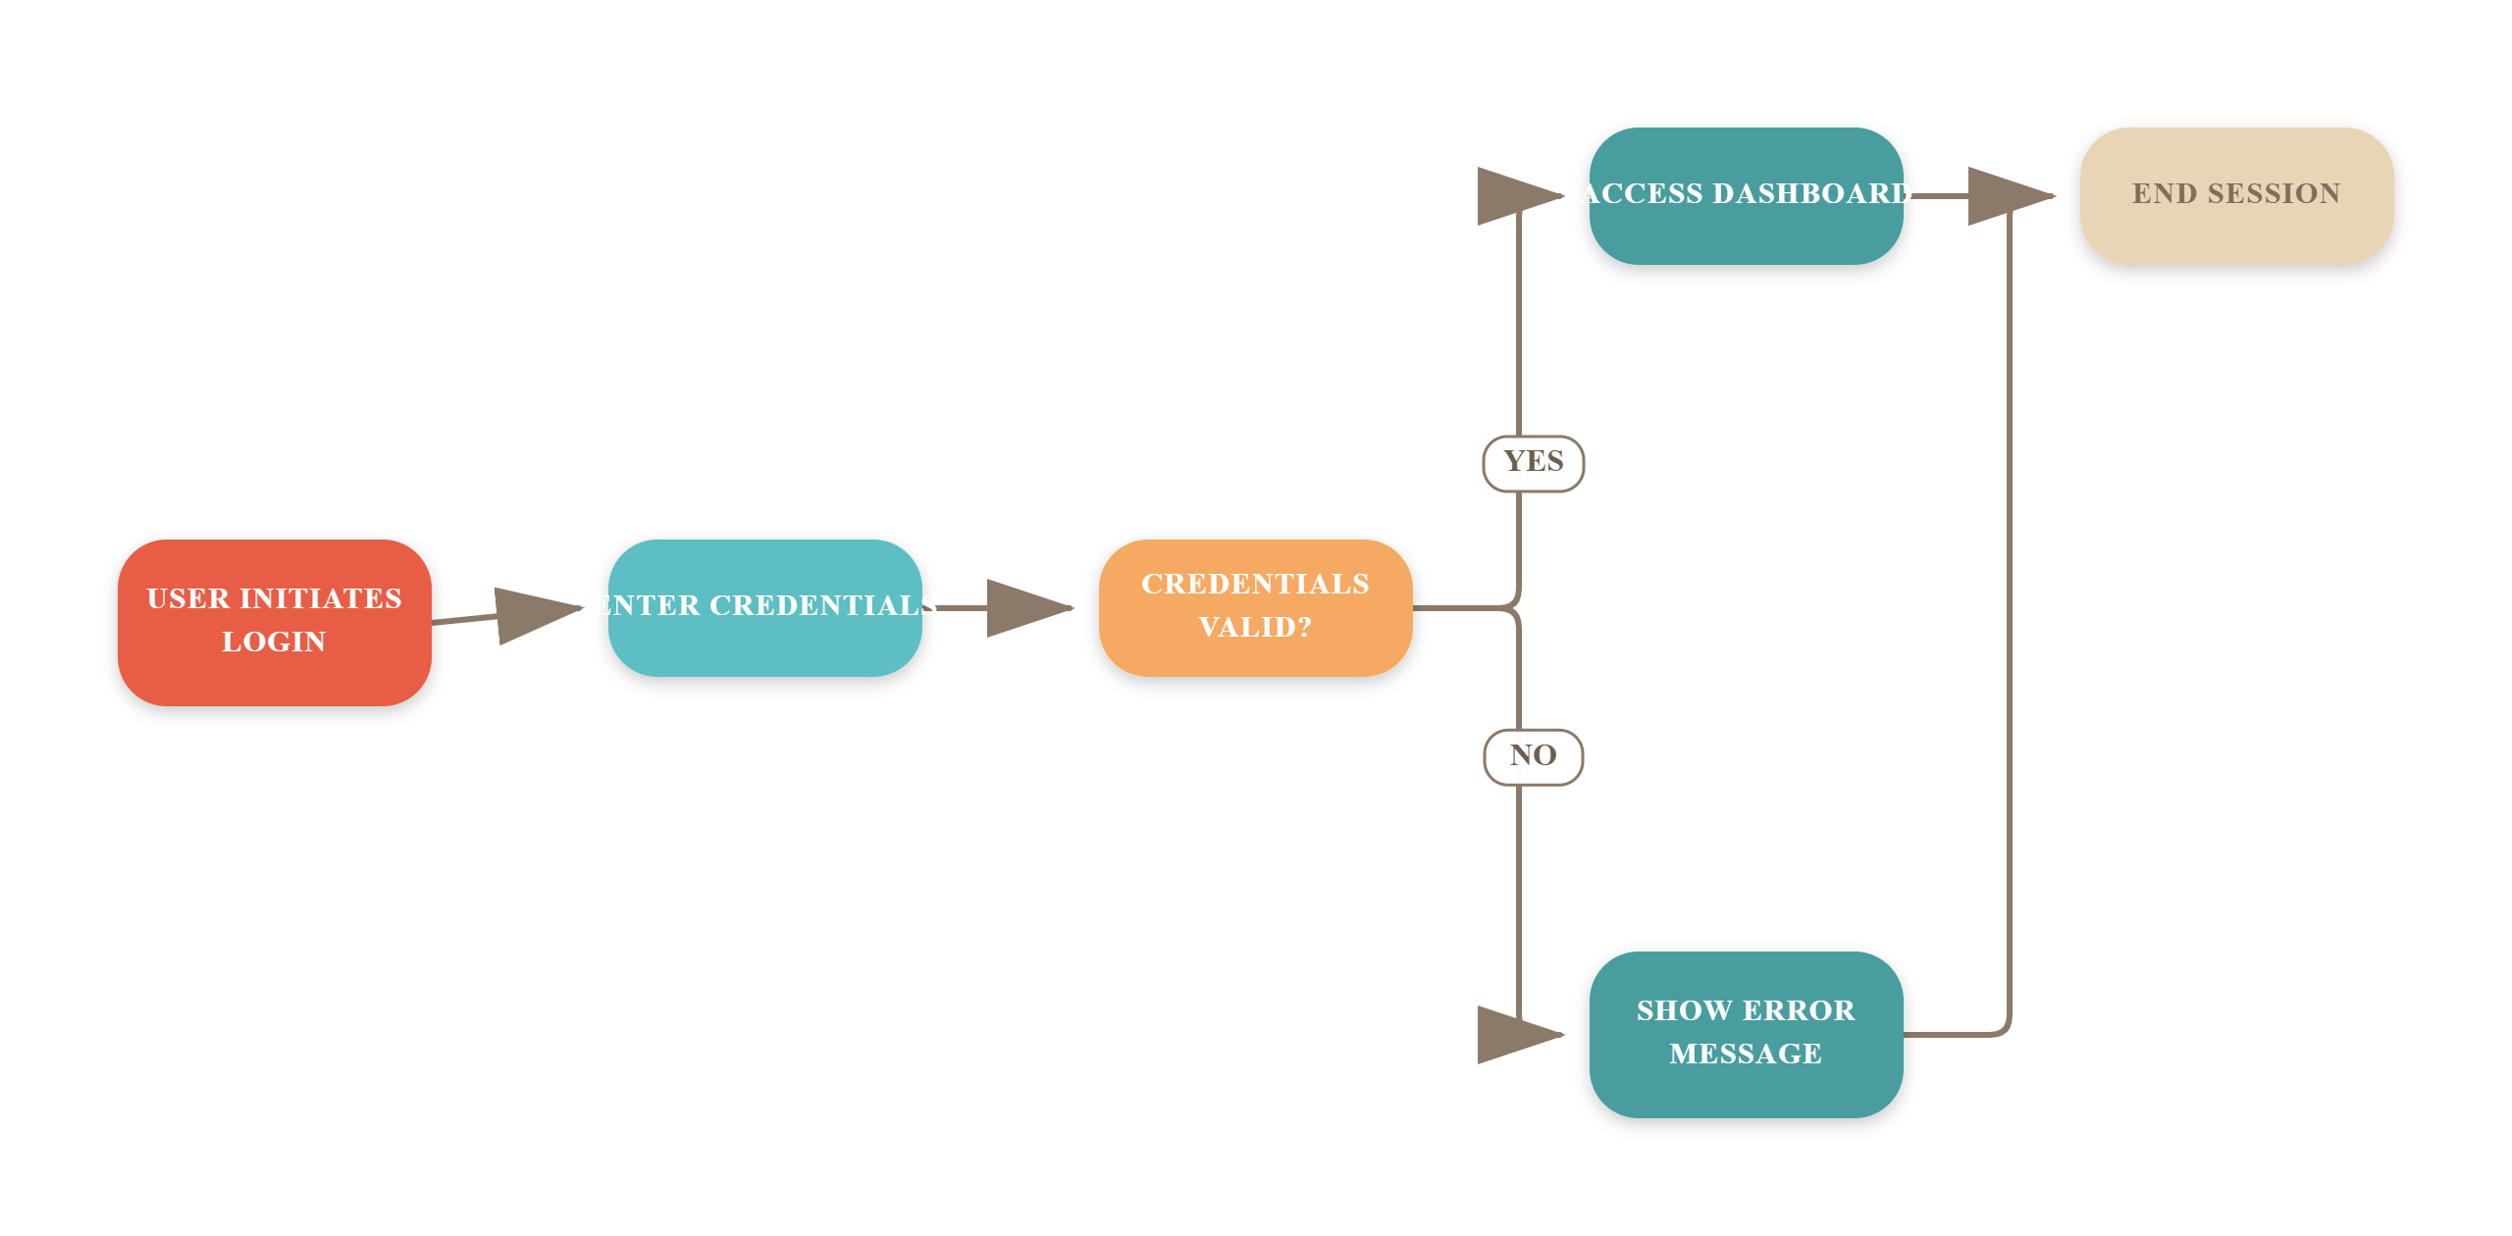
User Workflow & System Operations

Slide 10
Future Enhancement
✓
Security & Authentication Enhancements
Use PDO or MySQLi prepared statements across all PHP query files (login.php, register.php, profile.php) to prevent SQL Injection vulnerabilities.
✓
Functional & Architecture Upgrades
Role-Based Access Control (RBAC): Restrict access in auth.php based on explicit database roles (e.g., admin, doctor, patient) to prevent unauthorized portal viewing
✓
User Experience Improvements
Provide more language option for patient
Form Validation: Enhance script.js with client-side form validation feedback (real-time error messages for invalid emails, weak passwords, or empty fields) before submitting requests to PHP scripts.

Slide 11
THANK YOU

